Slide 1
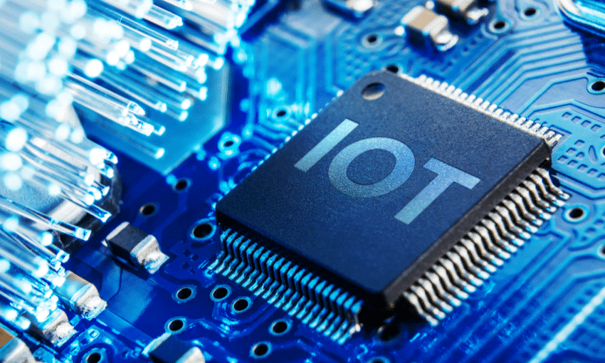
IOT PROJECT PRESENTATION
SESSION(2020-21)

Slide 2
Vehicle Tracker Using Google Map
Group Members-
Raj Gupta(181500542)
Divyank Gupta(181500221)
Priyanshu Shukla(181500515)
Under the guidance of-
Mr. Ajitesh Kumar(Department of CEA)

Slide 3
Contents
Problem Statement
Introduction
Software Requirement
List of Components
Layout
Circuit diagram
NodeMCU
GPS Module
Features
Advantages
Applications
Conclusion

Slide 4
Problem Statement
Vehicle tracking
Children Location for safety purpose
Stolen vehicle
Order tracking
Trip history

Slide 5
Introduction
Vehicle tracking is a most common module being used in automobiles
Mostly used in shipping businesses
A reliable system for knowing the location of specific thing (mobile,cars,package,etc.)

Slide 6
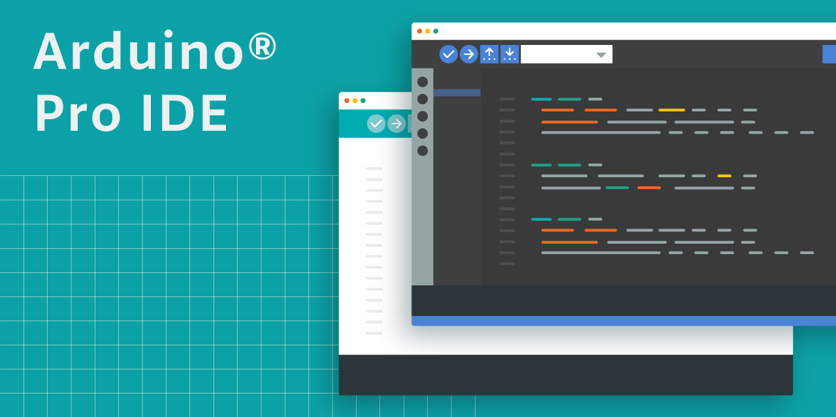


Software Requirement
Arduino IDE
Blynk App

Slide 7
List of Component
Node MCU
GPS Module
Jumper wires
Laptop
Power supply
16*2 LCD (optional)

Slide 8
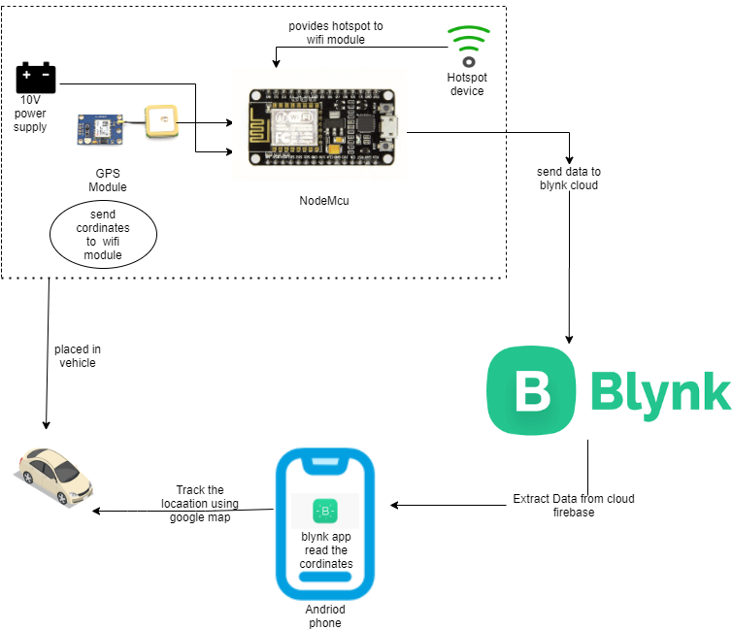
Layout

Slide 9
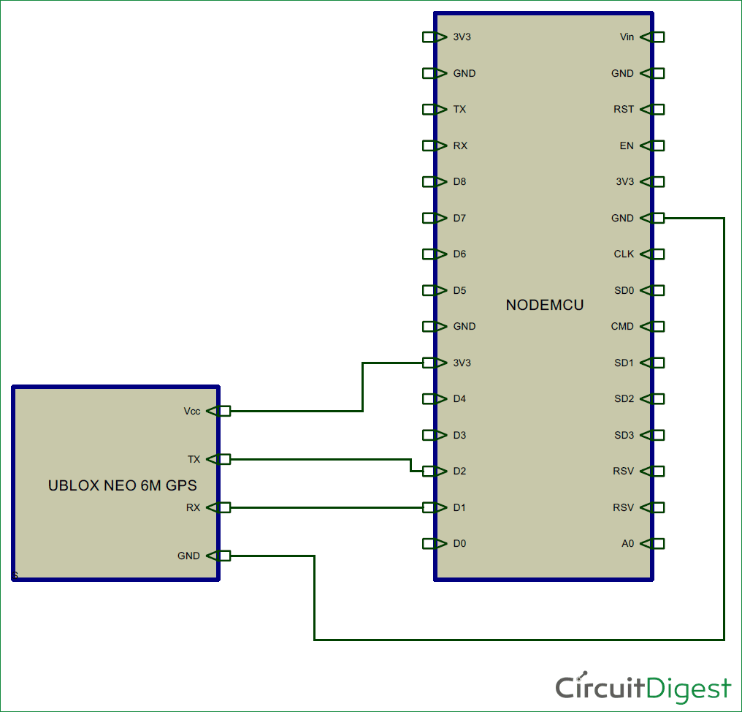
Circuit Diagram

Slide 10
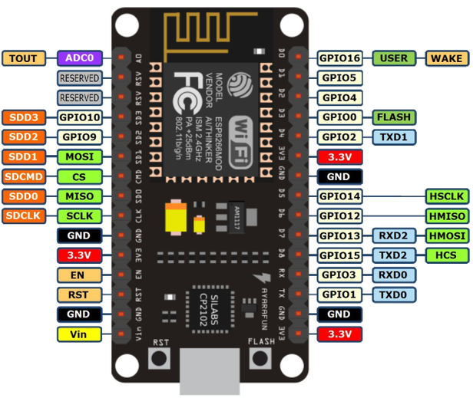
Nodemcu
Inbuilt wifi
Input voltage range 4.5V-10V
4 MB Flash memory
Temperature range -40ºC to 125ºC

Slide 11
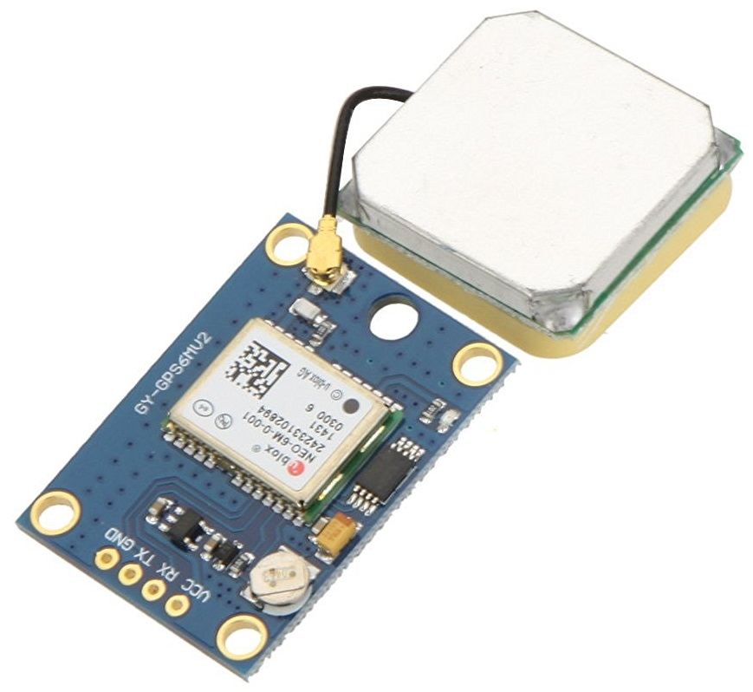
GPS Module
Operating voltage Range 2.7V- 6V
Tempeature range -40ºC to 85ºC
Average cold/warm start time 27s

Slide 12
Features
Real time location tracker
Customizable Alerts
Driver Behavior Monitoring
Trip history

Slide 13
Advantages
See a moving target (car,bus,item,etc.) in real time
Position accuracy
Improve Safety
Low operational cost
Based on true GPS satellite signals.
Theft Recovery

Slide 14
Applications
Security of your vehicles
To trace the location of your vehicle
To find stolen vehicles
Shipment Tracking

Slide 15
Conclusion
Nowaday’s most essential for most of the thing(car,mobile,etc.)
This technology can also help to advance the system of transportation
used in many organization for security purpose and tracking purpose.
vehicle theft is rapidly increasing, can be controlled well

